Slide 1
AI TRAVEL PLANNER AGENT
IBM AICTE PROJECT
Presented By: Janmejay Yagneshkumar Pandya
Student name : Janmejay Yagneshkumar Pandya
College Name & Department : LDRP-ITR, Computer Engineering

Slide 2
OUTLINE
Problem Statement
Technology used
Wow factor
End users
Result
Conclusion
Git-hub Link
Future scope
IBM Certifications

Slide 3
PROBLEM STATEMENT
Challenge:
Travel planning is often fragmented, time-consuming, and stressful. Users struggle to find optimal destinations, accommodations, and transport options that match their preferences and budget.
Proposed Solution:
An AI-powered Travel Planner Agent that:
- Understands user preferences, budget, and constraints
- Suggests destinations, builds itineraries
- Recommends transport and accommodation
- Integrates maps, weather updates, and local guides
- Manages bookings and alerts users to changes
- Optimizes schedules dynamically for a smooth travel experience

Slide 4
TECHNOLOGY USED
- IBM Cloud Lite Services
- Natural Language Processing (NLP)
- Prompt Engineering with IBM Granite
- IBM Cloud Services Used:
- IBM Watsonx AI Studio
- IBM Watsonx AI Runtime
- IBM Cloud Agent Lab
- IBM Granite Foundation Model

Slide 5
IBM CLOUD SERVICES USED
IBM Cloud Watsonx AI Studio
IBM Cloud Watsonx AI runtime
IBM Cloud Agent Lab
IBM Granite foundation model

Slide 6
WOW FACTORS
Impactful Benefits:
- Transforms complex travel planning into a seamless experience
- Saves time and reduces stress
- Offers personalized, real-time recommendations
- Adapts to changes during travel
Unique Features:
- AI-generated itineraries based on user input
- Budget-aware planning
- Smart alerts and booking management
- Integration with weather and location-based services

Slide 7
END USERS
Frequent Travelers
Travel Agencies
Solo and Group Tourists
Corporate Travel Planners
Hospitality Industry

Slide 8
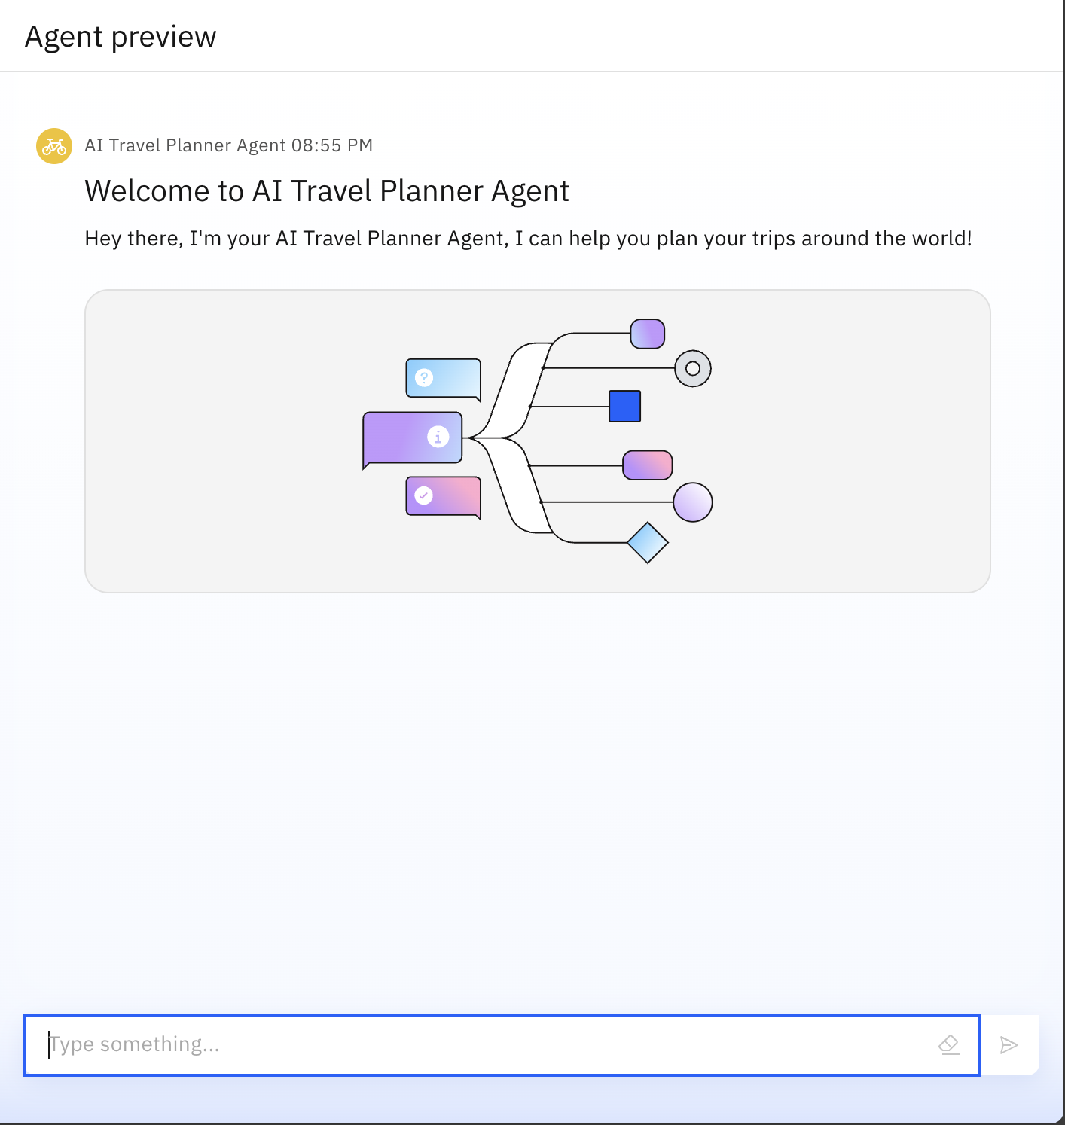
RESULTS

Slide 9
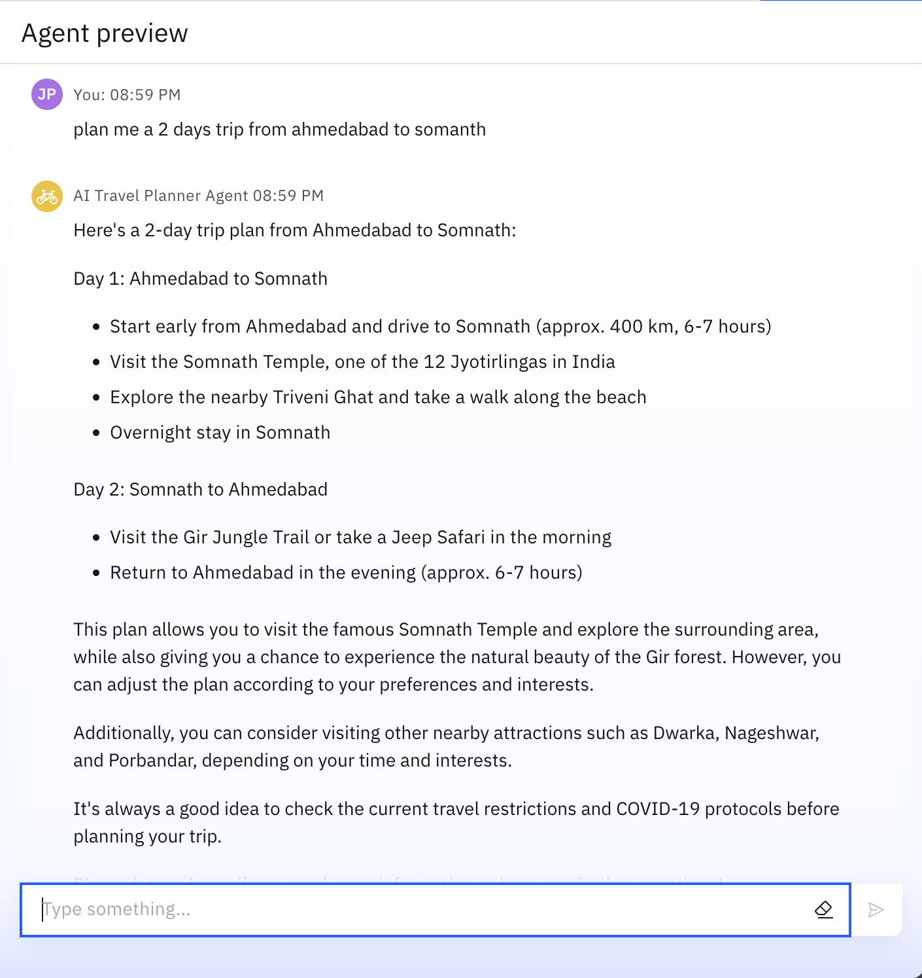
RESULTS

Slide 10
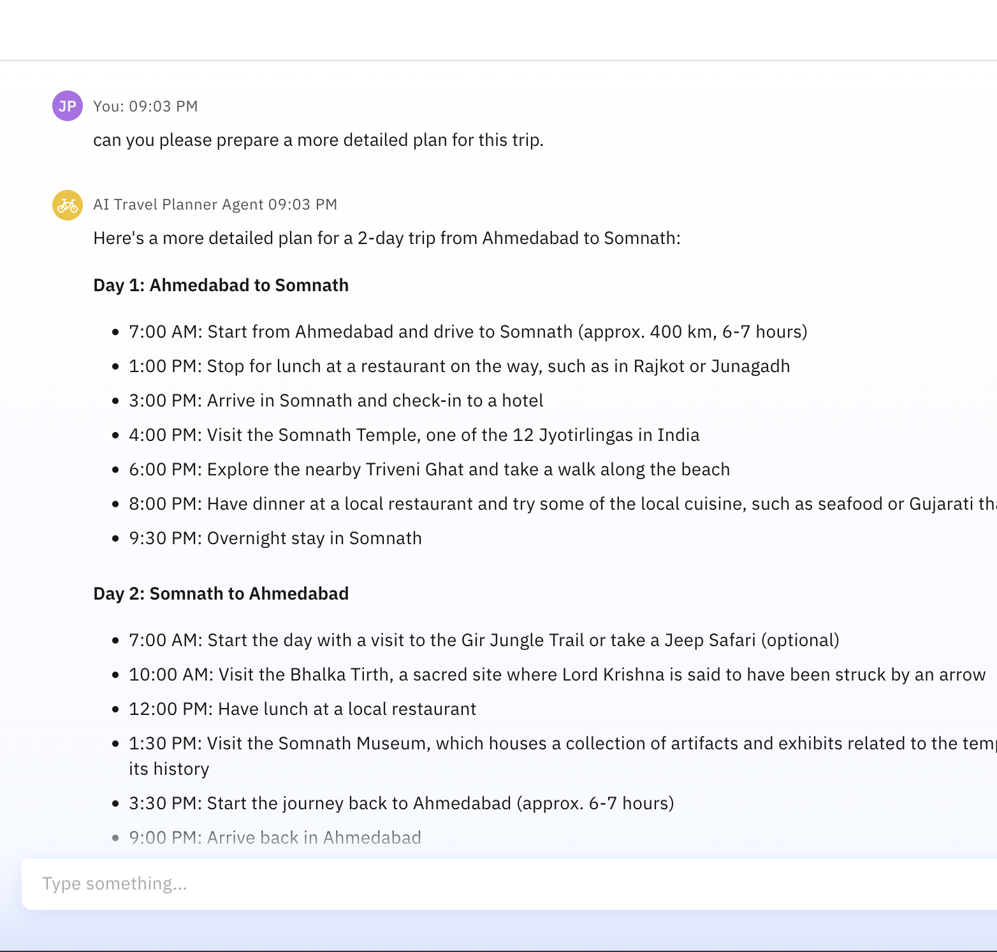
RESULTS

Slide 11
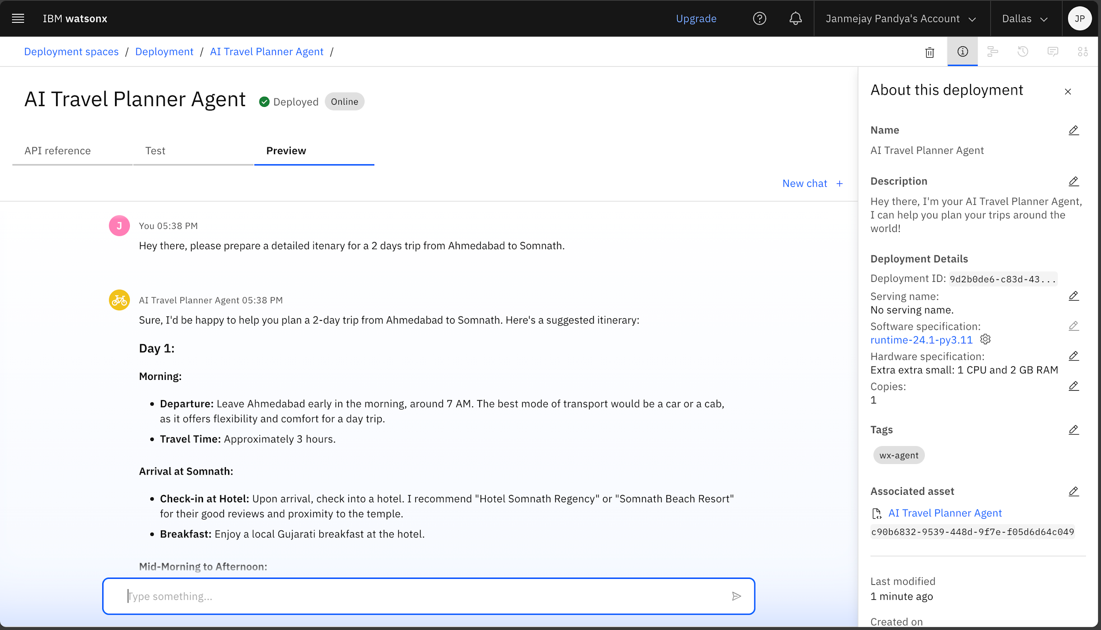
RESULTS
Deployed AI Agent

Slide 12
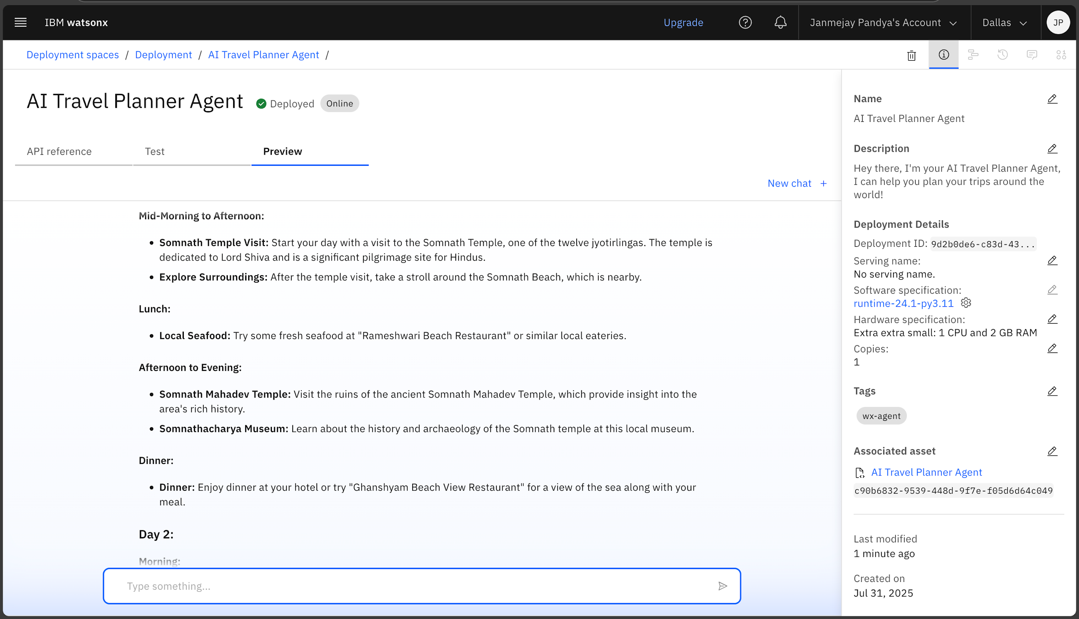
RESULTS
Deployed AI Agent

Slide 13
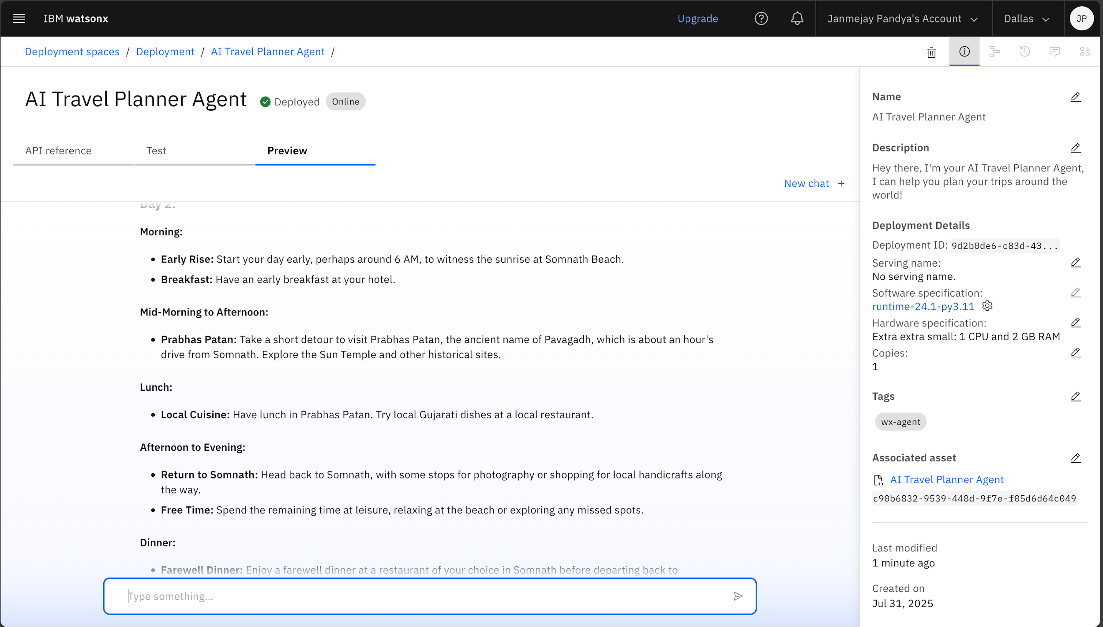
RESULTS
Deployed AI Agent

Slide 14
CONCLUSION
The Travel Planner Agent simplifies trip planning using AI
Enhances user experience with personalization and automation
Leverages IBM Cloud and Granite for scalable, intelligent solutions
Demonstrates real-world impact of AI in consumer applications

Slide 15
GITHUB LINK
https://github.com/Janmejay-Pandya01/IBM-AI-Cloud-Internship-AICTE-Edunet-Foundation.git

Slide 16
FUTURE SCOPE
Multilingual Travel Support
Voice-Activated Travel Assistant
Real-Time Group Collaboration Features
Sustainable Travel Recommendations
Integration with Booking & Review Platforms
AI-Assisted Travel Blog Drafting

Slide 17
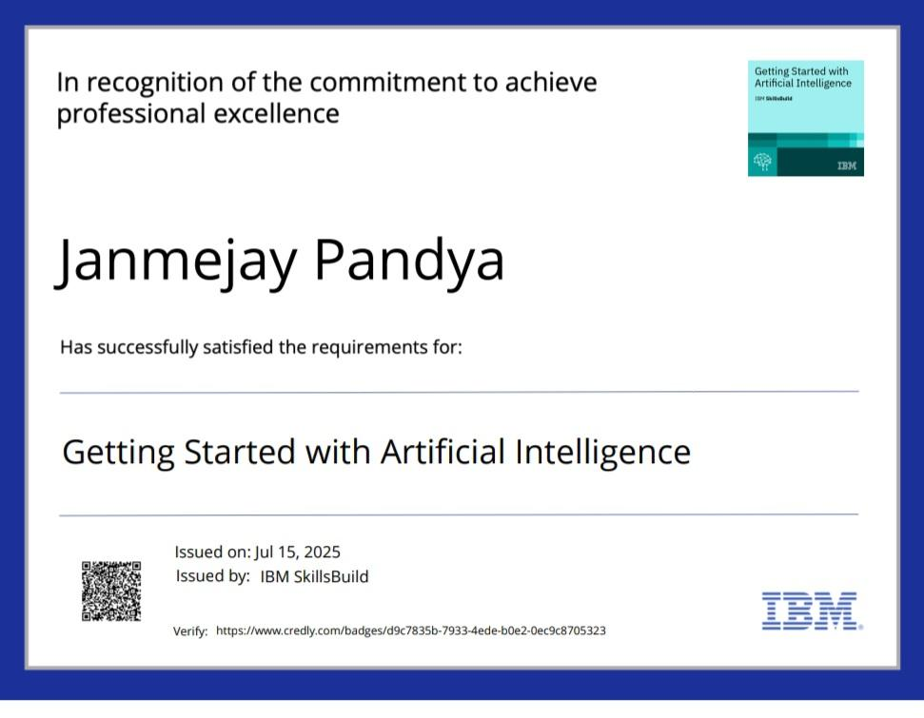
IBM CERTIFICATIONS
Getting Started with Artificial Intelligence

Slide 18
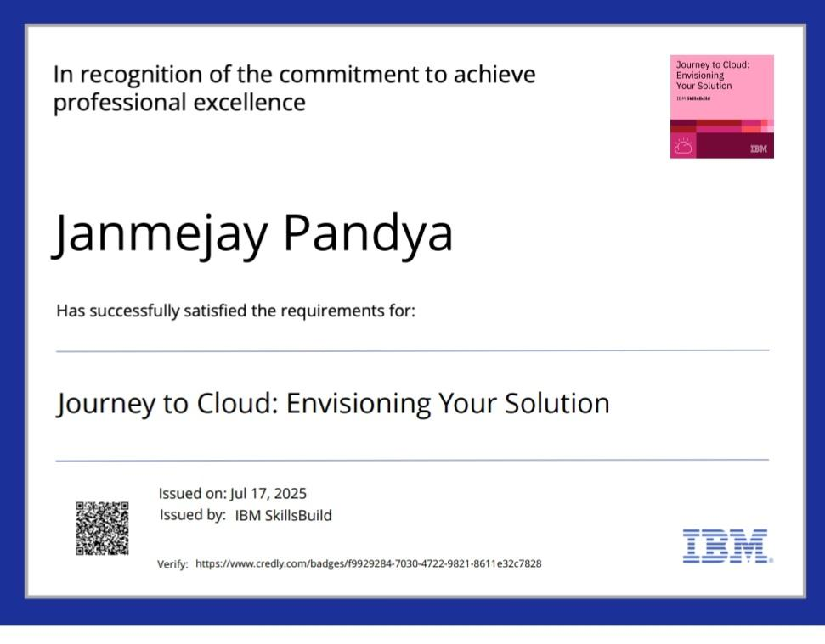
IBM CERTIFICATIONS
Journey to Cloud: Envisioning Your Solution

Slide 19
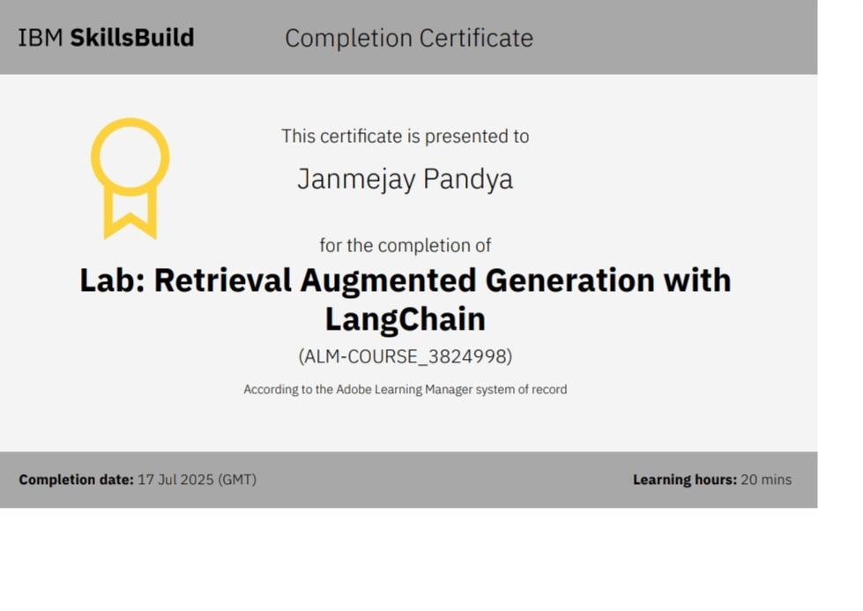
IBM CERTIFICATIONS
Lab: Retrieval Augmented Generation with LangChain

Slide 20
THANK YOU

